Slide 1


Topic selection for Machine Learning Project
By
Kazi Mosaddequr 1831543042
Samya Sunibir Das 1911563642
Emon Emtiyaz 1813128642

Slide 2

Topics:
New book price detection from rokomari database
Identifying if a university student has Internet gaming disorder or not
Problematic Internet use by peer review.

Slide 3

New book price detection from rokomari database

Slide 4
Objective
We want to find a price point where we can sell new books at the best price. The new writer can also see the effect they may have if they vary the feature that hey have in book. Moreover, this project will be interesting because we at the end of the project we will be able to find out the factors that affect the sales of the book.

Slide 5
Dataset
Title length | Author name length | Publisher | number of page | country | language | price

Slide 6
Dataset
Title | Author | Publisher | ISBN | Edition | Year | Number of pages | Country | Language | price
মস্তিষ্কের ক্যানভাস | সোলায়মান সুখন | অধ্যয়ন | 9789848072165 | 1st Published | 2019 | 136 | বাংলাদেশ | বাংলা | 203
ভাল্লাগে না | আয়মান সাদিক | আদর্শ | 9789848040170 | 1st Published | 2019 | 166 | বাংলাদেশ | বাংলা | 225
প্যারাময় লাইফের প্যারাসিটামল | ঝংকার মাহবুব | আদর্শ | 9789848040263 | 1st Published | 2019 | 124 | বাংলাদেশ | বাংলা | 195
স্টুডেন্ট হ্যাকস | আয়মান সাদিক | অধ্যয়ন | 9789848072172 | 4th Printed | 2018 | 150 | বাংলাদেশ | বাংলা | 203
Goodwill Factory | Rituraj Bhowmick | Pencil Publications | 978-984-96232-5-0 | 1st Published | 2022 | 52 | Bangladesh | English | 299

Slide 7
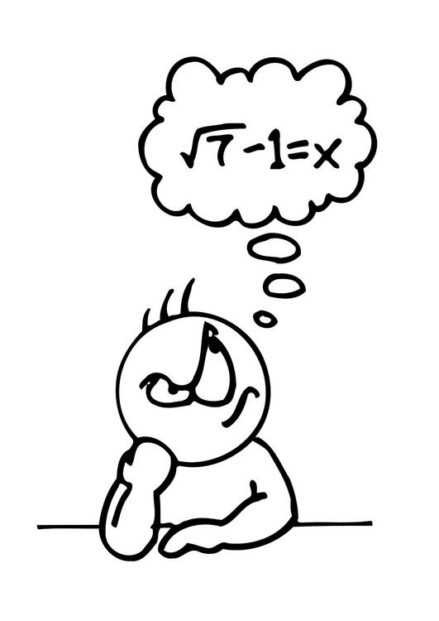
Difficulty

Slide 8
Dataset
Title | Author | Publisher | ISBN | Edition | Year | Number of pages | Country | Language | price
মস্তিষ্কের ক্যানভাস | সোলায়মান সুখন | অধ্যয়ন | 9789848072165 | 1st Published | 2019 | 136 | বাংলাদেশ | বাংলা | 203
ভাল্লাগে না | আয়মান সাদিক | আদর্শ | 9789848040170 | 1st Published | 2019 | 166 | বাংলাদেশ | বাংলা | 225
প্যারাময় লাইফের প্যারাসিটামল | ঝংকার মাহবুব | আদর্শ | 9789848040263 | 1st Published | 2019 | 124 | বাংলাদেশ | বাংলা | 195
স্টুডেন্ট হ্যাকস | আয়মান সাদিক | অধ্যয়ন | 9789848072172 | 4th Printed | 2018 | 150 | বাংলাদেশ | বাংলা | 203
Goodwill Factory | Rituraj Bhowmick | Pencil Publications | 978-984-96232-5-0 | 1st Published | 2022 | 52 | Bangladesh | English | 299
Bangla and English mixed. May cause problem

Slide 9
Identifying if a university student has Internet gaming disorder or not

Slide 10
What is internet gaming disorder
Internet Gaming Disorder is a psychological problem related to online gaming. Moreover, it is the online gaming addiction that is commonly found in young people these days.
In Bangladesh, with the availability of faster internet, we may have this kind of problem and we want to find it through machine learning.

Slide 11

Objective
Finding Internet gaming disordered people through machine learning.

Slide 12
Dataset
There are 26 features in the dataset
Sports
Age
Parent-Child
Stream
Medium
Sex
Siblings
Ethnicity
Income
Unions
Aesthetics
Sleep Hours /d
Sleep Quality
SQ Category
Online Learning
Teacher-Student
Appearance
No/Few Friends
Self-esteem Gamer? (Yes/No)
Game Type
Weekday Hours
Weekend Hours
Genre
Device
Start Age
Source: https://data.mendeley.com/datasets/8r2jgm6ygh/3

Slide 13
Dataset
One output
Sports
Age
Parent-Child
Stream
Medium
Sex
Siblings
Ethnicity
Income
Unions
Aesthetics
Sleep Hours /d
Sleep Quality
SQ Category
Online Learning
Teacher-Student
Appearance
No/Few Friends
Self-esteem Gamer? (Yes/No)
Game Type
Weekday Hours
Weekend Hours
Genre
Device
Start Age
IGD Status
Source: https://data.mendeley.com/datasets/8r2jgm6ygh/3

Slide 14
Dataset
27 columns
Number | Questionnaire | Age | Stream | Medium | Sex | Siblings | Ethnicity | Income | Sports | Unions | Aesthetics | Sleep Hours /d | Sleep Quality | SQ Category | Online Learning | Parent-Child | Teacher-Student
1 | Sinhala | 18 | Arts | Sinhala | M | Two | Sinhala | 100000-199999 | Moderate | Minor | Moderate | 4 to 5 | 6 | Average | 3 | 4 to 5 | 6
2 | Sinhala | 18 | Commerce | Sinhala | M | Two | Sinhala | 50000-99999 | Moderate | Moderate | Minor | 4 to 5 | 5 | Average | 3 | 4 to 5 | 5
3 | Sinhala | 18 | Commerce | Sinhala | M | Two | Sinhala | 100000-199999 | Minor | Minor | Minor | 6 to 7 | 8 | Good | 3 | 6 to 7 | 8
4 | Sinhala | 18 | Commerce | Sinhala | M | One | Sinhala | 100000-199999 | Minor | Minor | Moderate | 6 to 7 | 8 | Good | 3 | 6 to 7 | 8
5 | Sinhala | 18 | Commerce | Sinhala | M | None | Sinhala | 20000-49999 | Moderate | Minor | Moderate | 4 to 5 | 5 | Average | 3 | 4 to 5 | 5
6 | Sinhala | 16 | Commerce | Sinhala | M | One | Sinhala | more than 200000 | Minor | Minor | Minor | 6 to 7 | 5 | Average | 4 | 6 to 7 | 5
7 | Sinhala | 18 | Commerce | Sinhala | M | None | Sinhala | 100000-199999 | Moderate | Major | Major | 4 to 5 | 8 | Good | 4 | 4 to 5 | 8
8 | Sinhala | 18 | Commerce | Sinhala | M | Two | Sinhala | 100000-199999 | Minor | Moderate | Moderate | 6 to 7 | 5 | Average | 3 | 6 to 7 | 5
9 | Sinhala | 18 | Commerce | Sinhala | M | One | Sinhala | 100000-199999 | Minor | Moderate | Minor | 4 to 5 | 5 | Average | 4 | 4 to 5 | 5
10 | Sinhala | 18 | Commerce | Sinhala | M | One | Sinhala | 100000-199999 | Moderate | Minor | Major | 6 to 7 | 9 | Good | 4 | 6 to 7 | 9
11 | Sinhala | 18 | Commerce | Sinhala | M | One | Sinhala | 100000-199999 | Minor | Minor | None | 6 to 7 | 9 | Good | 2 | 6 to 7 | 9
12 | Sinhala | 18 | Arts | Sinhala | M | Two | Other | 50000-99999 | None | Major | Major | 4 to 5 | 9 | Good | 4 | 4 to 5 | 9
13 | Sinhala | 18 | Arts | Sinhala | M | One | Sinhala | 100000-199999 | Moderate | Moderate | Minor | 6 to 7 | 7 | Good | 3 | 6 to 7 | 7
14 | Sinhala | 18 | Arts | Sinhala | M | One | Sinhala | 100000-199999 | None | Minor | None | 6 to 7 | 8 | Good | 4 | 6 to 7 | 8
15 | Sinhala | 18 | Arts | Sinhala | M | Two | Sinhala | 20000-49999 | Major | None | None | 6 to 7 | 7 | Good | 3 | 6 to 7 | 7
16 | Sinhala | 17 | Arts | Sinhala | M | None | Sinhala | 20000-49999 | Major | Moderate | Moderate | 6 to 7 | 7 | Good | 3 | 6 to 7 | 7
17 | Sinhala | 18 | Arts | Sinhala | M | One | Sinhala | 100000-199999 | Minor | None | Minor | 6 to 7 | 5 | Average | 4 | 6 to 7 | 5
18 | Sinhala | 18 | Arts | Sinhala | M | One | Other | 50000-99999 | Moderate | None | Moderate | 6 to 7 | 5 | Average | 5 | 6 to 7 | 5
19 | Sinhala | 18 | Arts | Sinhala | M | None | Sinhala | more than 200000 | Moderate | Minor | None | 4 to 5 | 5 | Average | 4 | 4 to 5 | 5
20 | Sinhala | 18 | Arts | Sinhala | M | One | Sinhala | more than 200000 | Minor | Minor | Moderate | 4 to 5 | 3 | Poor | 4 | 4 to 5 | 3
21 | Sinhala | 18 | Commerce | Sinhala | M | One | Sinhala | 50000-99999 | Minor | Major | Minor | 4 to 5 | 9 | Good | 5 | 4 to 5 | 9
22 | Sinhala | 18 | Commerce | Sinhala | M | 3 or more | Sinhala | less than 20000 | Minor | None | None | 6 to 7 | 7 | Good | 3 | 6 to 7 | 7
23 | Sinhala | 17 | Commerce | Sinhala | M | Two | Sinhala | more than 200000 | Moderate | Minor | Major | 4 to 5 | 4 | Average | 2 | 4 to 5 | 4
24 | Sinhala | 16 | Physical | Sinhala | M | 3 or more | Sinhala | more than 200000 | Minor | None | Moderate | 6 to 7 | 7 | Good | 4 | 6 to 7 | 7
25 | Sinhala | 17 | Physical | Sinhala | M | One | Sinhala | 100000-199999 | None | Moderate | Moderate | 6 to 7 | 7 | Good | 3 | 6 to 7 | 7
26 | Sinhala | 17 | Physical | Sinhala | M | One | Sinhala | 50000-99999 | Major | None | Minor | 6 to 7 | 8 | Good | 4 | 6 to 7 | 8
27 | Sinhala | 17 | Physical | Sinhala | M | Two | Sinhala | 20000-49999 | Minor | Minor | Minor | 4 to 5 | 5 | Average | 4 | 4 to 5 | 5
28 | Sinhala | 17 | Physical | Sinhala | M | One | Sinhala | 100000-199999 | Moderate | Moderate | Minor | 6 to 7 | 6 | Average | 1 | 6 to 7 | 6
29 | Sinhala | 16 | Physical | Sinhala | M | One | Sinhala | more than 200000 | Minor | None | None | 4 to 5 | 4 | Average | 3 | 4 to 5 | 4
30 | Sinhala | 16 | Physical | Sinhala | M | Two | Sinhala | 20000-49999 | None | None | None | 6 to 7 | 10 | Ecellent | 2 | 6 to 7 | 10
31 | Sinhala | 17 | Physical | Sinhala | M | One | Sinhala | more than 200000 | Minor | None | Minor | 6 to 7 | 6 | Average | 3 | 6 to 7 | 6
32 | Sinhala | 17 | Physical | Sinhala | M | Two | Sinhala | 100000-199999 | Minor | None | Minor | 4 to 5 | 6 | Average | 3 | 4 to 5 | 6
33 | Sinhala | 17 | Physical | Sinhala | M | Two | Sinhala | 50000-99999 | Moderate | None | None | 6 to 7 | 7 | Good | 1 | 6 to 7 | 7
395 records
Source: https://data.mendeley.com/datasets/8r2jgm6ygh/3

Slide 15
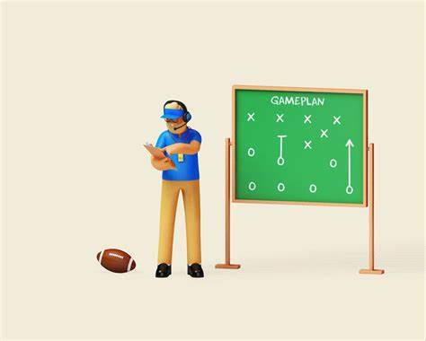
Our plan

Slide 16
Tech Requirements
Our plan
Given dataset
Collected from NSU

Slide 17
Problematic Internet use by peer review.

Slide 18

Objective
Find if the partner is addicted to internet use or not

Slide 19
Dataset
There are 9 features in the dataset
I know his/her gaming use (N/A?).
He/she prefers gaming than socializing.
His/her acquaintances and/or parents are concerned about his gaming.
Gaming impair his/her health, hygiene and eating pattern.
He/she avoids other activities?
He/she tried to stop gaming but failed.
Does gaming negatively affect his/her school performance?
I rate his/her gaming as (0=never plays, 3=extremely harmful).
My friend's sex is: F - female, M - male.
Source: https://data.mendeley.com/datasets/df52vdhft6/1

Slide 20
Dataset
One output
I know his/her gaming use (N/A?).
He/she prefers gaming than socializing.
His/her acquaintances and/or parents are concerned about his gaming.
Gaming impair his/her health, hygiene and eating pattern.
He/she avoids other activities?
He/she tried to stop gaming but failed.
Does gaming negatively affect his/her school performance?
I rate his/her gaming as (0=never plays, 3=extremely harmful).
My friend's sex is: F - female, M - male.
Internet addiction status
Source: https://data.mendeley.com/datasets/df52vdhft6/1

Slide 21
Dataset
9 columns
Q1 | Q2 | Q3 | Q4 | Q5 | Q6 | Q7 | Q8 | Q9
1.5 | 0 | 0 | 0 | 0.5 | 2 | 1.5 | 0 | M | S
0.5 | 0.5 | 0.5 | 0.5 | 0 | 1 | 0 | 0 | W | s
0.5 | 0 | 0 | 0 | 0 | 0 | 0 | 0 | M | s
1.5 | 0.5 | 0 | 0 | 0 | 0 | 0 | 0 | W | s
2 | 1.5 | 0.5 | 0.5 | 1 | 1 | 1 | 0 | M | s
2.5 | 2 | 1.5 | 1.5 | 1 | 1 | 1 | 1 | M | s
2 | 2 | 2 | 2 | 2 | 1.5 | 2 | 3 | M | s
2.5 | 2.5 | 2 | 2 | 2 | 1 | 2 | 2 | M | N
3 | 3 | 2.5 | 2 | 2 | 1.5 | 2 | 3 | M | n
280 records
Source: https://data.mendeley.com/datasets/df52vdhft6/1

Slide 22
Our plan

Slide 23
Tech Requirements
Our plan
Given dataset
Collected from NSU
1
2
Internet usage rather than gaming

Slide 24

Thank You!
Any questions are welcomed.

